Slide 1
Veterinary Parasitology “Jeopardy”
1st Edition

Slide 2
Definitions | Definitive Host | Common Names | Identification | Site of Infection
100 | 100 | 100 | 100 | 100
200 | 200 | 200 | 200 | 200
300 | 300 | 300 | 300 | 300
400 | 400 | 400 | 400 | 400
500 | 500 | 500 | 500 | 500
Double

Slide 3
A close association between two different species of organisms, one of which, the PARASITE depends on the other, the HOST, deriving some benefit from it without necessarily damaging it

Slide 4
What is parasitism?

Slide 5
Time during which developmental stages of parasites have not been produced to give evidence of their presence

Slide 6
What is prepatent period?

Slide 7
A potential host in which there is no required development of the immature parasite but the organism remains infective for the definitive host

Slide 8
What is a paratenic host?

Slide 9
It means cylindrical or round

Slide 10
What is “strongyl”?

Slide 11
Infection with adult Dirofilaria immitis, but microfilariae are not being produced or detected

Slide 12
What is an occult infection?

Slide 13
The D. H. for Ascaris suum

Slide 14
What is a pig?

Slide 15
The D. H. for Nematodirus battus

Slide 16
What is a sheep or goat?

Slide 17
The D. H. for Stephanurus dentatus

Slide 18
What is a pig?

Slide 19
The D. H. for Dictyocaulus arnfieldi

Slide 20
What is a donkey or horse?

Slide 21
The D. H. for Parelaphostrongylus tenuis

Slide 22
What is a white-tailed deer?

Slide 23
Trichuris vulpis

Slide 24
What is the canine whipworm?

Slide 25
CELEBRITY
DAILY
DOUBLE
A common nematode parasite
of horses whose eggs are almost
never seen in fecal examinations

Slide 26
What is a pinworm?

Slide 27
Haemonchus placei

Slide 28
What is the barber-pole worm of cattle?

Slide 29
Trichostrongylus axei

Slide 30
What is the stomach hair worm?

Slide 31
Angiostrongylus vasorum

Slide 32
What is french heartworm?

Slide 33
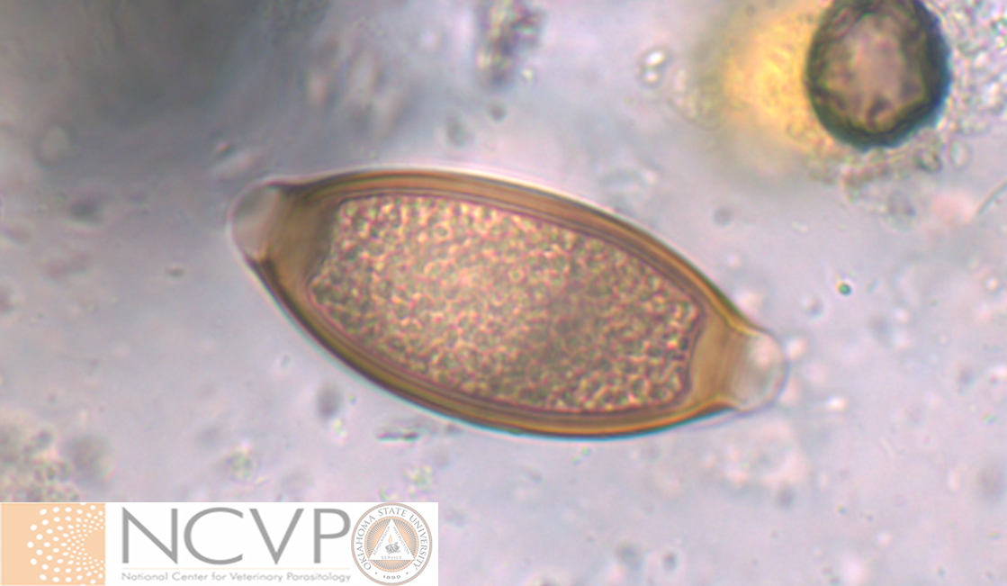
Fecal flotation (Genus species) from a pig

Slide 34
What is Trichuris suis?

Slide 35
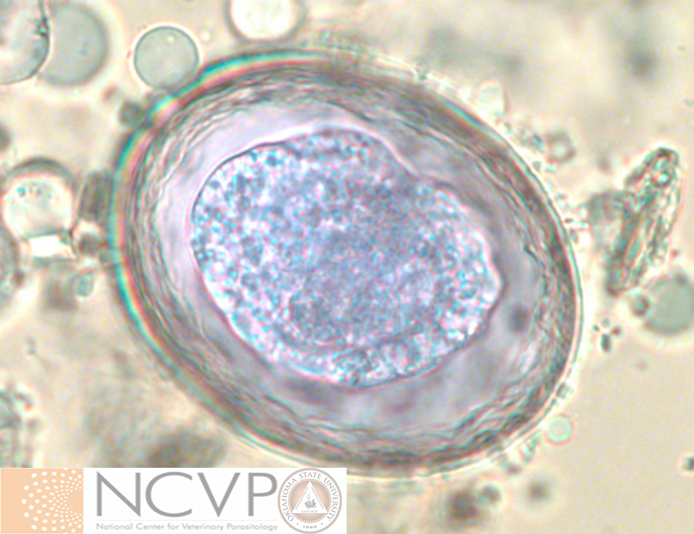
Fecal flotation (Genus species) from a cat

Slide 36
What is Toxascaris leonina?

Slide 37
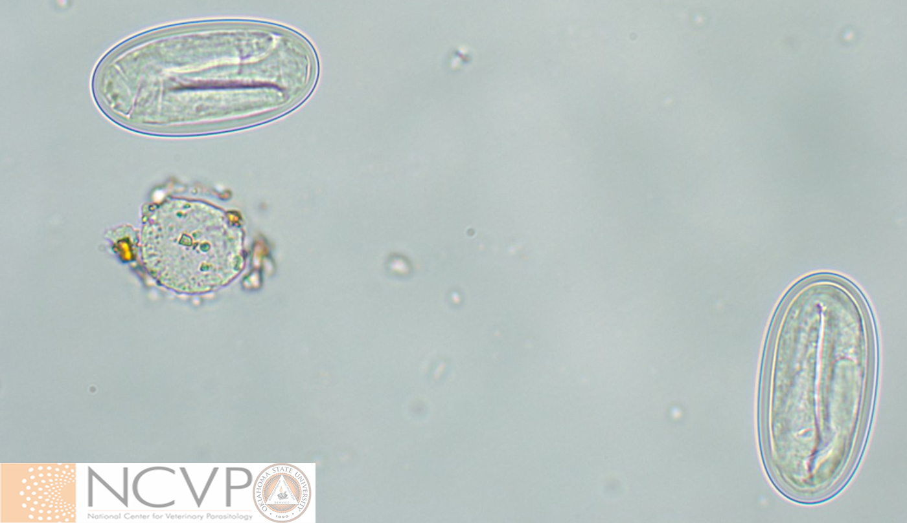
Fecal flotation (Genus) from a dog

Slide 38
What is Physaloptera spp.?

Slide 39
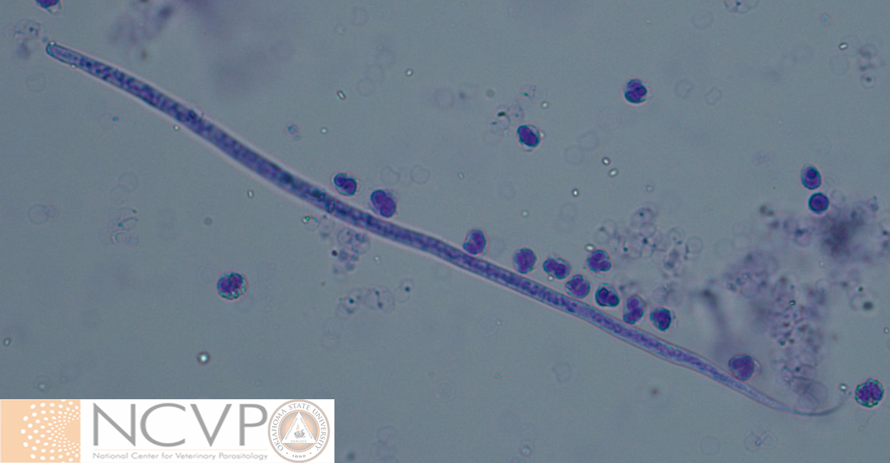
Modified Knott’s (Genus species) from canine blood
Length is 250 µm and width is 5.0 µm

Slide 40
What is Acanthocheilonema reconditum?

Slide 41
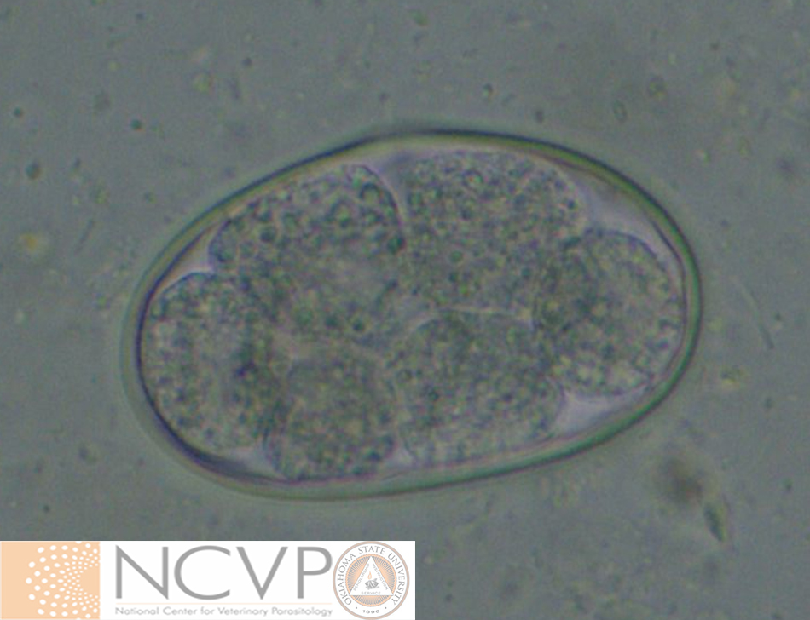
Fecal flotation (Genus) from a dog
Length is 90 µm and width is 58 µm

Slide 42
What is Uncinaria spp.?

Slide 43
Adult Ancylostoma tubaeforme

Slide 44
What is the small intestine?

Slide 45
Juvenile (L3 and L4) of Ostertagia ostertagi

Slide 46
What is the gastric gland of the abomasum?

Slide 47
Adult Trichinella spiralis

Slide 48
What are the small intestines?

Slide 49
Adult Acanthocheilonema reconditum

Slide 50
What is subcutaneous connective tissues?

Slide 51
Adult Parelaphostrongylus tenuis

Slide 52
What is meninges and venous sinuses?

Slide 53
Infective Stages | Pathogenesis & Clinical Signs | Intermediate Hosts | Diagnostics | Zoonotic Parasites
200 | 200 | 200 | 200 | 200
400 | 400 | 400 | 400 | 400
600 | 600 | 600 | 600 | 600
800 | 800 | 800 | 800 | 800
1000 | 1000 | 1000 | 1000 | 1000
Final

Slide 54
The infective stage for Ancylostoma caninum

Slide 55
What is the third-stage juvenile worm?

Slide 56
The infective stage for Toxocara canis.

Slide 57
What is the third-stage juvenile worm within an egg?

Slide 58
The infective stage for Dirofilaria immitis.

Slide 59
What is the third-stage juvenile worm?

Slide 60
The infective stage for Trichuris vulpis

Slide 61
What is the first-stage juvenile worm within an egg?

Slide 62
The infective stage for Filaroides osleri

Slide 63
What is the first-stage juvenile worm?

Slide 64
Pruritus ani in a horse

Slide 65
What is infection with Oxyuris equi?

Slide 66
Anemia due to voracious blood-sucking worms in a 3-day old puppy.

Slide 67
What is infection with Ancylostoma caninum?

Slide 68
Obstruction of blood flow and right-sided heart failure in a dog.

Slide 69
What is infection with Dirofilaria immitis?

Slide 70
Thickening of the cranial mesenteric artery in a young horse

Slide 71
What is infection with Strongylus vulgaris?

Slide 72
Respiratory distress and nasal discharge in a foal, can lead to verminous pneumonia

Slide 73
What is infection with Parascaris equorum?

Slide 74
The intermediate host for Dirofilaria immitis

Slide 75
What is a mosquito?

Slide 76
CELEBRITY
DAILY
DOUBLE
The intermediate host for the
common feline lungworm
(Aelurostrongylus abstrusus).

Slide 77
What is a snail or slug?

Slide 78
The intermediate host for Physaloptera spp.

Slide 79
What are dung beetles, cockroaches, or crickets?

Slide 80
The intermediate host for Metastrongylus spp.

Slide 81
What are earthworms?

Slide 82
The intermediate host for Dracunculus insignis

Slide 83
What is a copepod?

Slide 84
The recommended technique for the recovery of trematode eggs from a fecal sample

Slide 85
What is a fecal sedimentation?

Slide 86
Technique commonly used to quantify eggs per gram of feces from horses and small ruminants

Slide 87
What is the Modified McMaster’s technique?

Slide 88
The recommended technique for the detection of nematode larvae in a fecal sample
CELEBRITY
DAILY
DOUBLE

Slide 89
What is the Baermann technique?

Slide 90
Technique for concentration of microfilaria from blood that utilizes centrifugation.

Slide 91
What is Modified Knott’s?

Slide 92
Diagnostic assays for the detection of heartworm infection are designed to bind this antigen.

Slide 93
What is female worm uterine antigen?

Slide 94
Penetration of third stage juvenile worms of Ancylostoma spp.

Slide 95
What is Cutaneous larva migrans (CLM)?

Slide 96
Nematode transferred to humans through ingestion of contaminated, undercooked pork

Slide 97
What is Trichinella spiralis?

Slide 98
Ascarid (Genus species) from raccoons capable of causing disease in humans

Slide 99
What is Baylisascaris procyonis?

Slide 100
Disease in humans caused by infection of Toxocara canis or possibly Toxocara cati

Slide 101
What is Visceral Larva Migrans (VLM)?

Slide 102
Human infection with this nematode parasite (Genus species) of pigs has been linked with abatement of clinical signs in Crohn’s disease patients.

Slide 103
What is Trichuris suis?

Slide 104
Final Jeopardy
Category:
Aberrant hosts

Slide 105
Infection in cats with this nematode (Genus species) may culminate in respiratory disease and/or death.

Slide 106
What is Dirofilaria immitis?

Slide 107
And the winner is…

