Slide 1
Veterinary Parasitology “Jeopardy”
2nd Edition

Slide 2
Trematodes | Definitive Host | I.D. | Site of Infection | Cestodes
100 | 100 | 100 | 100 | 100
200 | 200 | 200 | 200 | 200
300 | 300 | 300 | 300 | 300
400 | 400 | 400 | 400 | 400
500 | 500 | 500 | 500 | 500
Double

Slide 3
The vector of Salmon-Poisoning Disease

Slide 4
What is Nanophyetus salmincola?

Slide 5
What is the large American fluke

Slide 6
What is Fascioloides magna?

Slide 7
The lung fluke of dogs and cats

Slide 8
What is Paragonimus kellicotti?

Slide 9
The fluke that causes Lizard-Poisoning Disease

Slide 10
What is Platynosomum fastosum?

Slide 11
The rumen fluke

Slide 12
What is Paramphistomum cervi?

Slide 13
The D. H. for Taenia pisiformis

Slide 14
What is a dog?

Slide 15
The D. H. for Haemonchus placei

Slide 16
What are cattle?

Slide 17
The D. H. for Taenia saginata

Slide 18
What is a human?

Slide 19
The D. H. (Genus species) for Cytauxzoon felis

Slide 20
What is a tick?
Amblyomma americanum/Dermacentor variabilis

Slide 21
The D. H. for Macracanthorhynchus hirudinaceus

Slide 22
What is a pig?

Slide 23
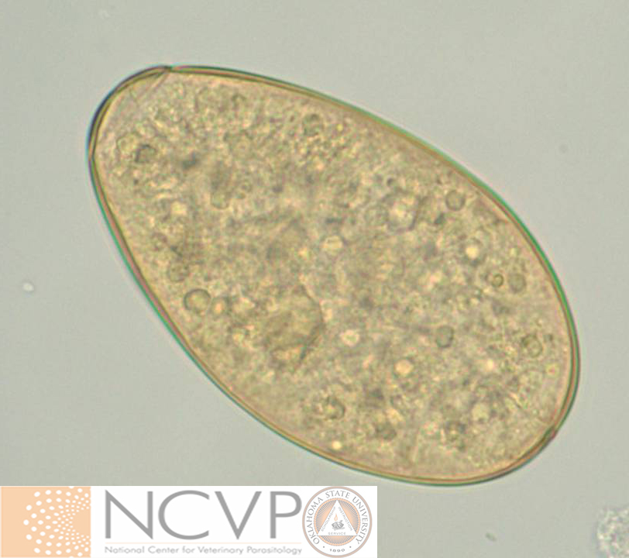
Found (Genus species) in a fecal sedimentation from a cow

Slide 24
What is Fasciola hepatica?

Slide 25
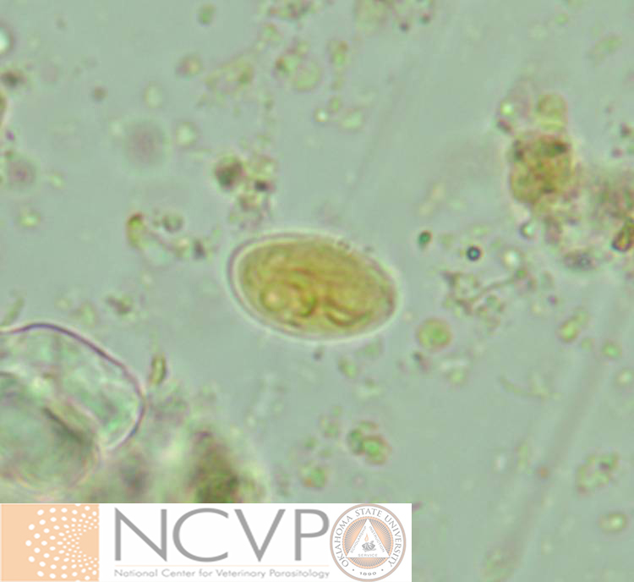
Found (Genus) in a fecal float from a dog
(then stained with iodine)

Slide 26
What is a Giardia cyst?

Slide 27
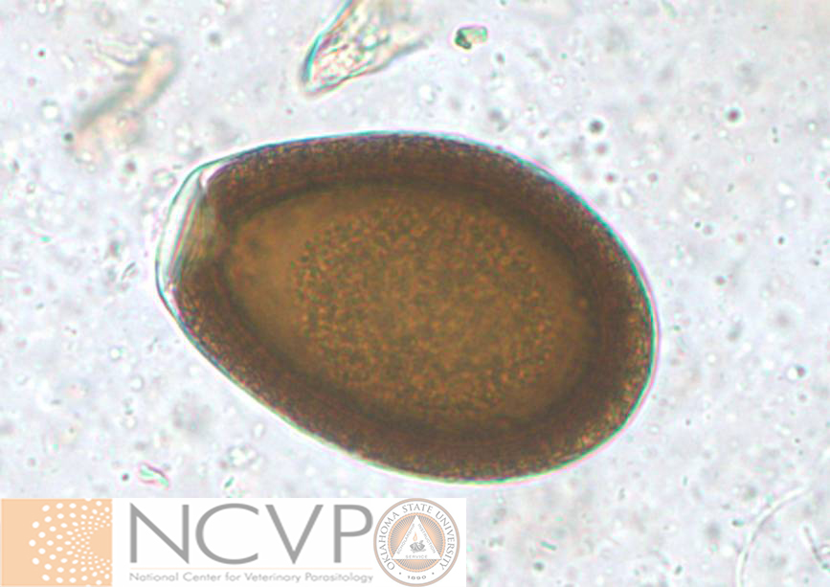
Found (Genus species) in a fecal float from a llama

Slide 28
What is Eimeria macusaniensis?

Slide 29
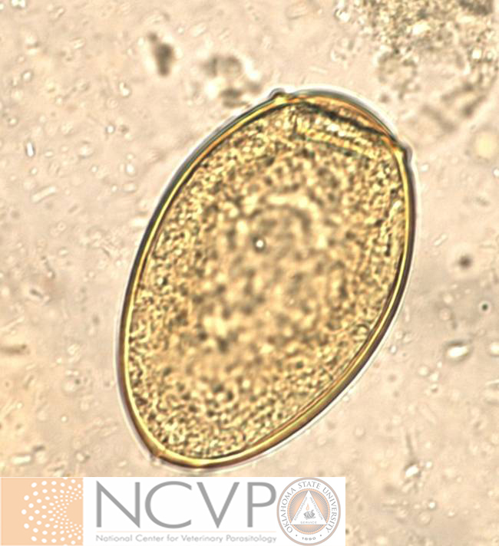
Found (Genus species) in a fecal sedimentation from a cat

Slide 30
What is Paragonimus kellicotti?

Slide 31
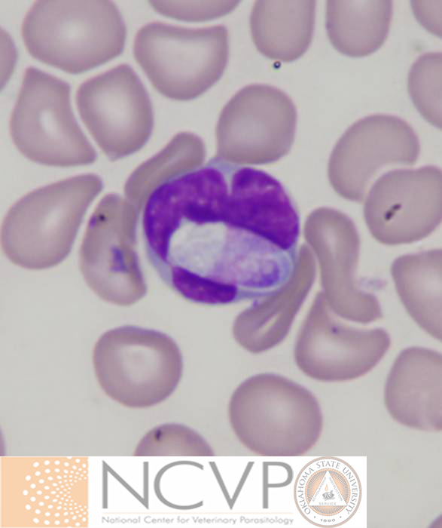
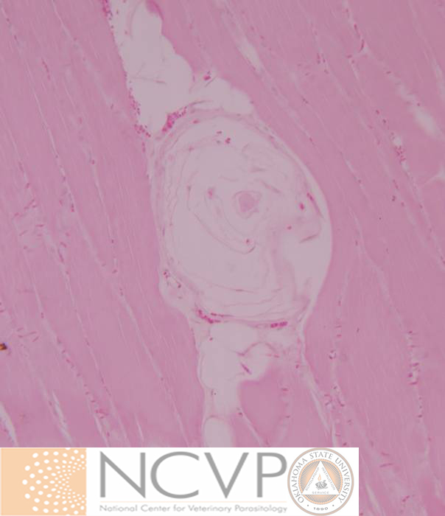
Found (Genus species) in a blood smear and muscle biopsy from a dog

Slide 32
What is Hepatozoon americanum?

Slide 33
The site of infection for adult Taenia pisiformis

Slide 34
What are the small intestines?

Slide 35
The site of infection for adult Gongylonema pulchrum

Slide 36
What is the esophagus?

Slide 37
CELEBRITY
DAILY
DOUBLE
A large nematode found in the right kidney of dogs

Slide 38
What is Dioctophyme renale?

Slide 39
The site of infection for adult small strongyles

Slide 40
What is the colon?

Slide 41
The site of infection for larval Taenia multiceps

Slide 42
What is the brain?

Slide 43
A non-pathogenic adult tapeworm (Genus) in a ruminant

Slide 44
What is Moniezia?

Slide 45
The canid/felid tapeworm (Genus species) acquired by ingesting an infected flea

Slide 46
What is Dipylidium caninum?

Slide 47
Equine tapeworm (Genus species) that preferentially feeds at the ileocecal junction

Slide 48
What is Anoplocephala perfoliata?

Slide 49
Human beef tapeworm (Genus species)

Slide 50
What is Taenia saginata?

Slide 51
Pseudophyllidian tapeworm (Genus species) of cats, most common in the southeastern U.S.

Slide 52
What is Spirometra mansonoides?

Slide 53
Intermediate Hosts | Pathogenesis & Clinical Signs | Metacestodes | Protozoa | Zoonotic Parasites
200 | 200 | 200 | 200 | 200
400 | 400 | 400 | 400 | 400
600 | 600 | 600 | 600 | 600
800 | 800 | 800 | 800 | 800
1000 | 1000 | 1000 | 1000 | 1000
Final

Slide 54
The I.H. for Fasciola hepatica

Slide 55
What is an aquatic snail?

Slide 56
The I.H. for Moniezia spp.

Slide 57
What is an oribatid mite?

Slide 58
This parasite (Genus species) was found by Wendell Krull to require an ant as well as a terrestrial snail to complete its life cycle
CELEBRITY
DAILY
DOUBLE

Slide 59
What is Dicrocoelium dendriticum?

Slide 60
The I.H. for Taenia taeniaformis

Slide 61
What is a rodent?

Slide 62
The 2nd I.H. for Paragonimus kellicotti

Slide 63
What is a crayfish?

Slide 64
Anemia due to voracious blood-sucking worms in a 2-week old kitten.

Slide 65
What is infection with Ancylostoma tubaeforme?

Slide 66
Thickening and fibrosis of bile ducts in response to the presence and feeding of adult parasites

Slide 67
What is infection with Fasciola hepatica?

Slide 68
Neurologic signs including ataxia along with muscle atrophy in a horse.

Slide 69
What is infection with Sarcocystis neurona?

Slide 70
Muscle wasting and periosteal bone proliferation

Slide 71
What is infection with Hepatozoon americanum?

Slide 72
The parasite of WTD that can cause liver failure and death in sheep and goats
CELEBRITY
DAILY
DOUBLE

Slide 73
What is infection with Fascioloides magna?

Slide 74
The infective larval stage of Dipylidium caninum in its flea host.

Slide 75
What is a cysticercoid?

Slide 76
The infective larval stage of Taenia pisiformis in its rabbit host

Slide 77
What is a cysticercus?

Slide 78
The infective larval stage of Taenia taeniaformis in its rodent host

Slide 79
What is a strobilocercus?

Slide 80
The infective larval stage of Echinococcus granulosus in its sheep host (be specific)

Slide 81
What is a unilocular hydatid cyst?

Slide 82
The infective larval stage of Mesocestoides sp. in its vertebrate intermediate host

Slide 83
What is a tetrathyridium?

Slide 84
Responsible (Genus) for causing “beaver fever”

Slide 85
What is Giardia?

Slide 86
Process by which sporozoites of Eimeria spp. are formed

Slide 87
What is sporogony?

Slide 88
The pre-patent period for infection with Cystoisospora spp. in dogs and cats

Slide 89
What is approximately 1 week?

Slide 90
Enteric protozoa (Genus) capable of autoinfection potentially resulting in prolonged diarrhea and death

Slide 91
What is Cryptosporidium sp.?

Slide 92
Term that refers to a group of protozoans that have electron dense organelles in their apical end

Slide 93
What is an apicomplexan?

Slide 94
Children can become infected with this parasite upon ingestion of an infected flea

Slide 95
What is Dipylidium caninum?

Slide 96
Humans are a host to both the larval (metacestode) and adults of this tapeworm

Slide 97
What is Taenia solium?

Slide 98
Common mosquito-borne filarid (Genus species) of dogs in North America that is capable of infecting humans

Slide 99
What is Dirofilaria immitis?

Slide 100
Freeze resistant species of nematode in which humans would be infected through ingestion of infected meat (typically wild carnivore) that was improperly cooked

Slide 101
What is Trichinella nativa/T6?

Slide 102
The name of the disease in which a human is infected with the pleurocercoid of Spirometra mansonoides

Slide 103
What is sparganosis?

Slide 104
Final Jeopardy
Category:
Parasitology History

Slide 105
Last names of the 2 men who first definitively linked the transmission of an infectious disease with an arthropod vector

Slide 106
Who are Smith and Kilbourne?

Slide 107
And the winner is…

