Slide 1
Veterinary Parasitology “Jeopardy”
3rd Edition

Slide 2
Giardia | Definitive Host | Intermediate Host | Site of Infection | Vector-borne
100 | 100 | 100 | 100 | 100
200 | 200 | 200 | 200 | 200
300 | 300 | 300 | 300 | 300
400 | 400 | 400 | 400 | 400
500 | 500 | 500 | 500 | 500
Double

Slide 3
Primary clinical sign associated with infection of Giardia spp.

Slide 4
What is diarrhea?

Slide 5
The common name associated with humans infected with Giardia spp.

Slide 6
What is Beaver Fever?

Slide 7
Fecal flotation medium recommended for floating cysts of Giardia spp.

Slide 8
What is zinc sulfate?

Slide 9
Preferred technique for visualization of motile trophozoites in a fresh fecal sample

Slide 10
What is a direct (saline) smear?

Slide 11
The prepatent period for infection of Giardia spp.

Slide 12
What is 1-2 weeks? (Can be as quick as 5 days)

Slide 13
The D. H. for Enterobius vermicularis

Slide 14
What is a human?

Slide 15
The suspected D. H. (be specific) for Leishmania infantum in the United States

Slide 16
What is an American Fox Hound?

Slide 17
The D. H. for Sarcocystis neurona

Slide 18
What is an opossum?

Slide 19
The D. H. (Genus species) for Hepatozoon americanum

Slide 20
What is an Amblyomma maculatum?

Slide 21
The D. H. for Heterobilharzia americana

Slide 22
What are dogs, raccoons, or bobcats?

Slide 23
The I.H. for Babesia bigemina

Slide 24
What are cattle?

Slide 25
The traditional I.H. for Toxoplasma gondii

Slide 26
What is a rodent?

Slide 27
The I.H. for Taenia multiceps

Slide 28
What is a sheep?

Slide 29
The I.H. for Parelaphostrongylus tenuis

Slide 30
What is a terrestrial snail/slug?

Slide 31
The second I.H. for Spirometra mansonoides

Slide 32
What is most any vertebrate besides fish?

Slide 33
The site of infection for Eimeria bovis

Slide 34
What is the intestinal tract?

Slide 35
The site of infection for Babesia gibsoni in dogs

Slide 36
What are red blood cells?

Slide 37
The site of infection for Demodex spp.

Slide 38
What are hair follicles and sebaceous glands?

Slide 39
The location of sarcocysts of Sarcocystis spp.

Slide 40
What are muscles of the I.H.?

Slide 41
The site of infection for adult Heterobilharzia americana

Slide 42
What are the mesenteric veins?

Slide 43
Vector (Genus and species) for Borrelia burgdorferi East of the Rocky Mountains

Slide 44
What is Ixodes scapularis?

Slide 45
Ingestion of caddisflies by a horse may result in this rickettsial disease (common name)

Slide 46
What is Potomac Horse Fever?

Slide 47
The most common vector (Genus species) of Rickettsia felis in Southern California
CELEBRITY
DAILY
DOUBLE

Slide 48
What is Ctenocephalides felis?

Slide 49
Vector (common name) of Trypanosoma theileri to cattle

Slide 50
What is a horse fly?

Slide 51
Vector (Genus) for human and primate malaria

Slide 52
What is Anopheles?

Slide 53
Parasite ID | Clinical Signs & Pathogenesis | Ectoparasites | Protozoa | Zoonotic Parasites
200 | 200 | 200 | 200 | 200
400 | 400 | 400 | 400 | 400
600 | 600 | 600 | 600 | 600
800 | 800 | 800 | 800 | 800
1000 | 1000 | 1000 | 1000 | 1000
Final

Slide 54
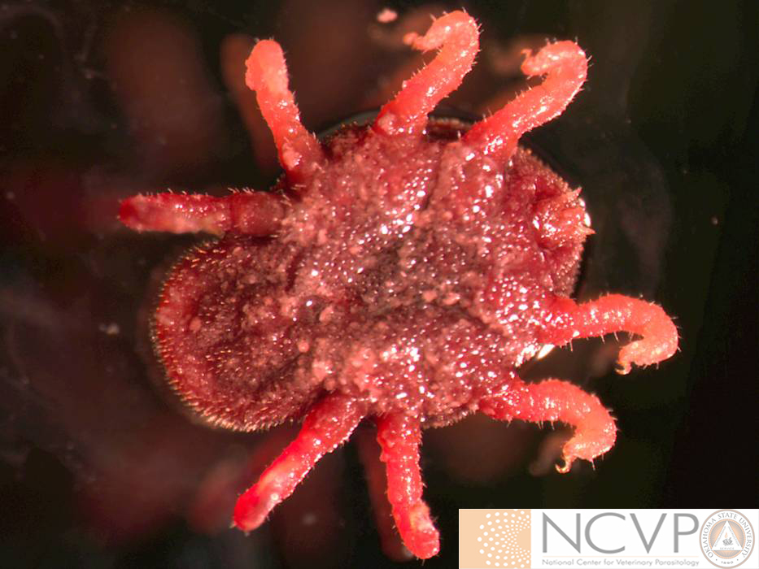
This tick (Genus species) was pulled from the ear canal of an alpaca

Slide 55
What is Otobius megnini?

Slide 56
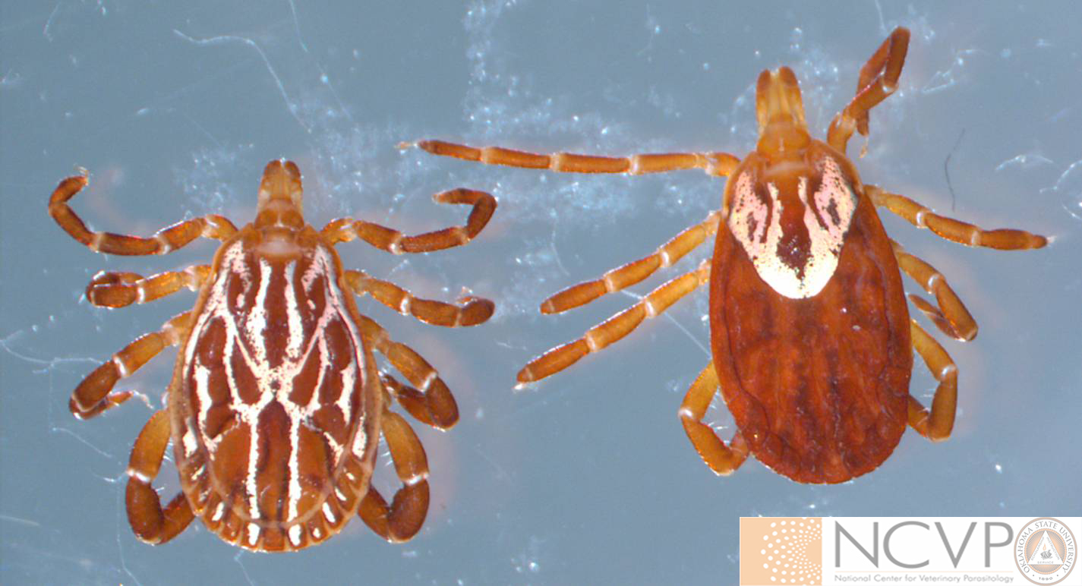
Tick (Genus species) found attached around the ear of a bull

Slide 57
What is Amblyomma maculatum?

Slide 58
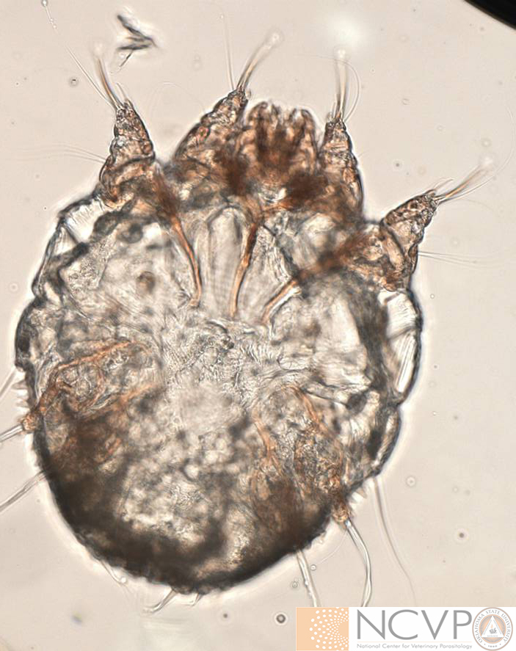
Ectoparasite (Genus species) recovered via deep skin scrape from a pruritic hog

Slide 59
What is Sarcoptes scabiei?

Slide 60
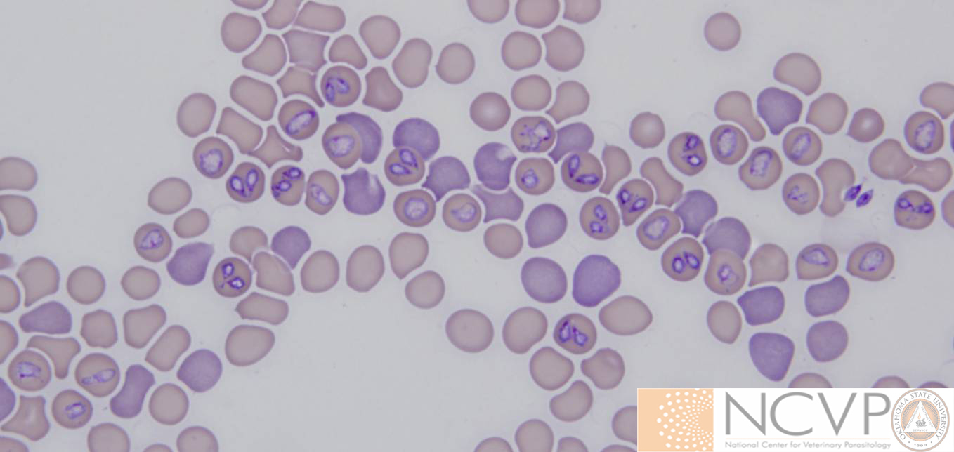
Parasite (Genus species) found on blood smear from a dog

Slide 61
What is Babesia canis?

Slide 62
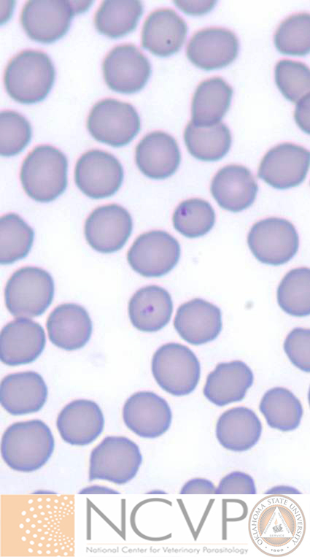
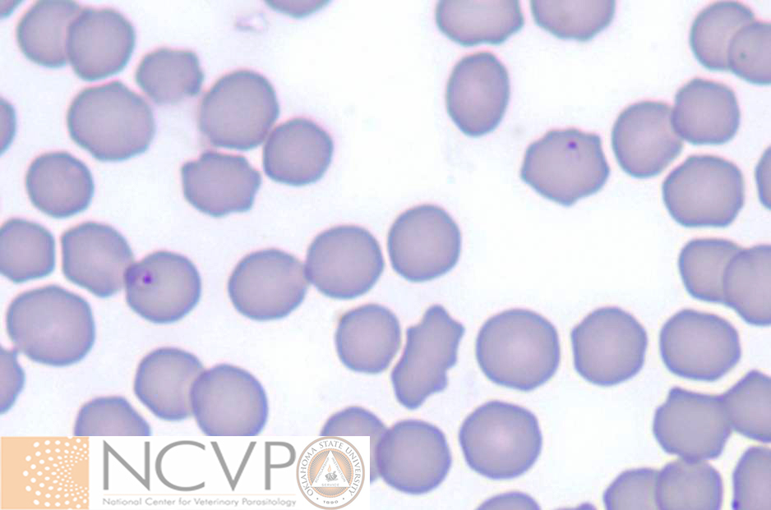
Parasite (Genus species) on blood smear from a febrile, anorexic cat.

Slide 63
What is Cytauxzoon felis?

Slide 64
Bot (Genus) that causes subcutaneous nodules in along the backs of cattle

Slide 65
What is Hypoderma?

Slide 66
Skin condition in a dog as a result of hypersensitivity to the saliva of Ctenocephalides felis

Slide 67
What is Flea Allergy Dermatitis?

Slide 68
Tick (Genus and species) that can cause exsanguination of dogs housed in kennels

Slide 69
What is Rhipicephalus sanguineus?

Slide 70
Hypersensitivity reactions (sweet itch) in horses are the result of bites from this fly (Genus)

Slide 71
What is Culicoides?

Slide 72
Parasite (Genus species) causes damage due to schizogonous replication in endothelial macrophages

Slide 73
What is infection with Cytauxzoon felis?

Slide 74
Type of arthropod metamorphosis in which juvenile forms resemble adult forms

Slide 75
What is simple metamorphosis?

Slide 76
CELEBRITY
DAILY
DOUBLE
The vector (Genus species) for Ehrlichia ewingii of dogs

Slide 77
What is Amblyomma americanum?

Slide 78
Genus species of the feline ear mite

Slide 79
What is Otodectes cynotis?

Slide 80
Fly (Genus species) with multiple common names (e.g. kennel fly) that lays its eggs in decaying organic matter

Slide 81
What is Stomoxys calcitrans?

Slide 82
Louse vector (Genus) for Dipylidium caninum to dogs

Slide 83
What is Trichodectes?

Slide 84
Encysted, slowly-dividing, stage of Toxoplasma gondii found within I.H. tissues

Slide 85
What is a bradyzoite?

Slide 86
CELEBRITY
DAILY
DOUBLE
Primary vector (Genus) for Texas Cattle Fever

Slide 87
What are Rhipicephalus (Boophilus) spp.?

Slide 88
Typically a non-pathogenic ciliate (Genus species) that infects the intestinal tract of swine.

Slide 89
What is Balantidium coli?

Slide 90
Flagellate (Genus species) transmitted by triatome kissing bugs that infects cardiac myocytes of a number of vertebrate species

Slide 91
What is Trypanosoma cruzi?

Slide 92
Flagellate (Genus) that replicates as an amastigote in macrophages.

Slide 93
What is Leishmania?

Slide 94
Bacteria (Genus) transmitted through flea feces

Slide 95
What is Bartonella?

Slide 96
Flea (Genus species) that is associated with the transmission of Yersinia pestis in the U.S.

Slide 97
What is Xenopsylla cheopis?

Slide 98
This mite (Genus) is associated with walking dandruff in dogs and cats and is capable of transiently infesting humans

Slide 99
What is Cheyletiella?

Slide 100
White-tailed deer are considered the reservoir host for this tick-borne rickettsial agent (Genus species) that infects monocytes of humans

Slide 101
What is Ehrlichia chaffeensis?

Slide 102
Protozoan parasite (Genus species) that has been linked with schizophrenia in humans

Slide 103
What is Toxoplasma gondii?

Slide 104
Final Jeopardy
Category:
Parasite Geography

Slide 105
The common name of an infection with Rickettsia rickettsii was given based on the geographical distribution of this arthropod vector
(Genus species)

Slide 106
What is Dermacentor andersoni?

Slide 107
And the winner is…

